Slide 1
Cash Vs Card Graphics in R
By Keidrick, Cliff, and Austin

Slide 2
Breakdown
Purpose
Constraints
Customer Experience
Strategic Decision Making
Operational Efficiency
Customer Preferences and Behavior
Card reader was out for three months in August at Popeyes.
Cash payments were inflated due to this issue.
Metrics Analyzation
Goals
Card Transactions in store.
Card Transactions through online/mobile orders.
Cash Transactions in store.
Develop a system that tracks card vs. cash transactions.
Track the average cost of each transaction respectively.

Slide 3
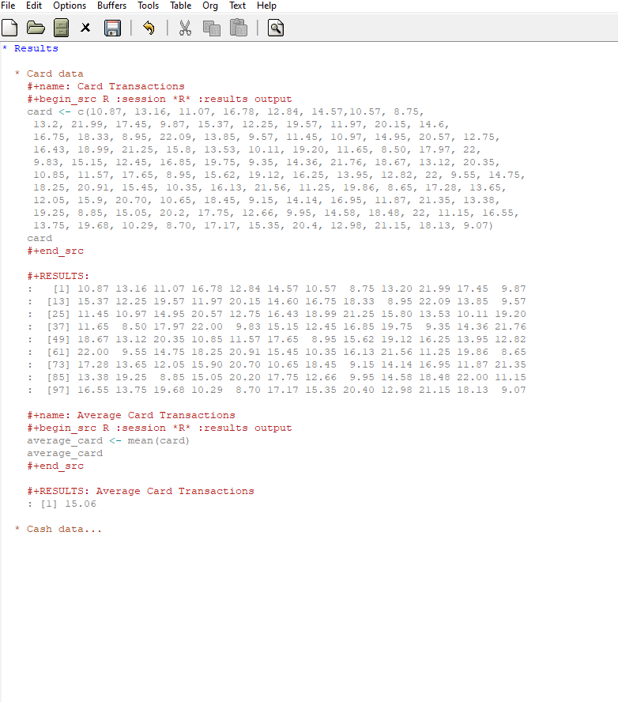

Slide 4
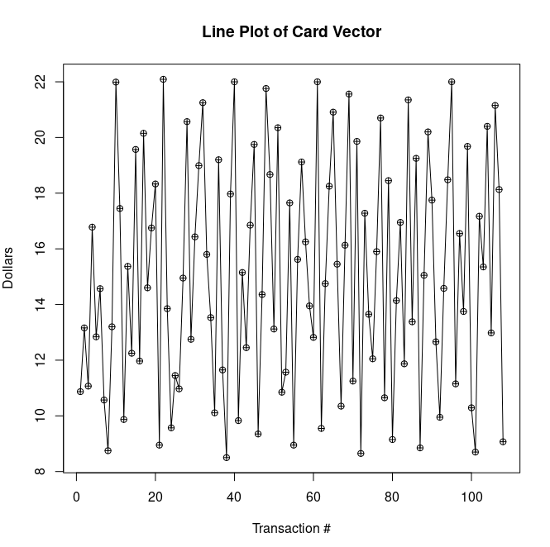
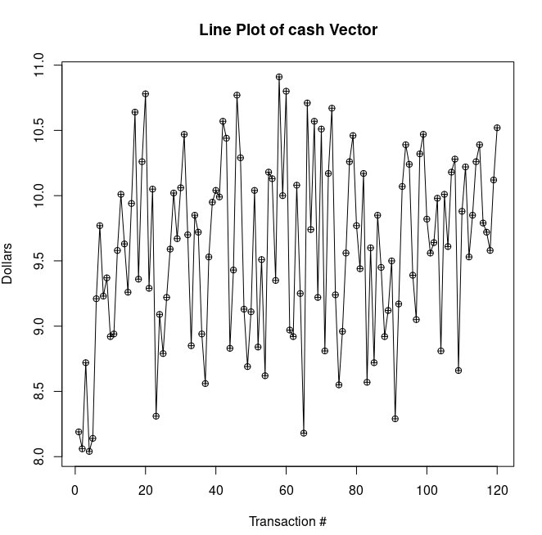
Line Plot of Cash Data
Line Plot of Card Data

Slide 5
Average Cash vs Card Transactions
Meanwhile, Cash users spent an average of $15.06.
On Average, Card users spent a total of $9.59.
Cash users spent an average of 57.03%over those who paid in card.

Slide 6
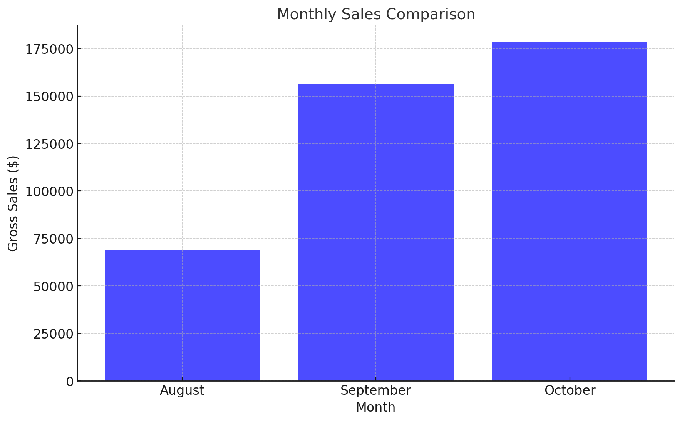

Slide 7
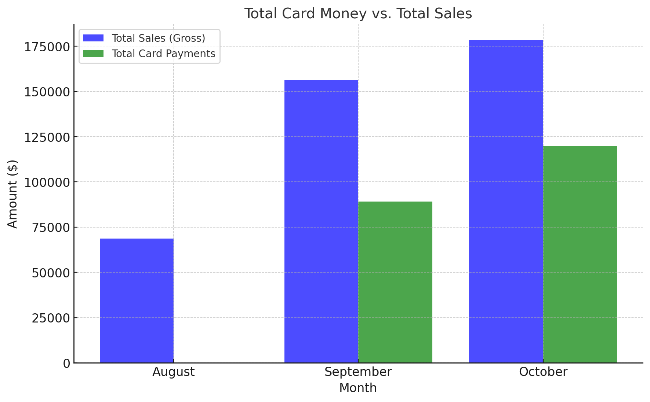

Slide 8
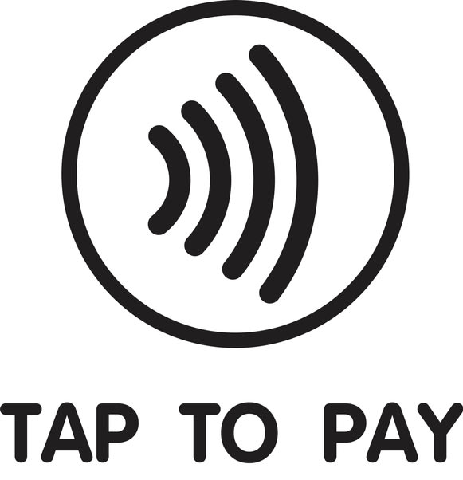
Conclusions
Card users spend less on each transaction by more the 50%.
Card users have greater transaction numbers and seem to be more frequent.
Overall, the conclusion is to offer as many payment types as possible but Tap to pay, Apple pay, and card readers are crucial for business.

Slide 9
References
01
Popeyes Louisiana Kitchen. (n.d.). About us. Retrieved
September 15, 2024, from https://www.popeyes.com/about-us
02
R Core Team. (2023). R: A language and environment for
statistical computing [Software]. R Foundation for Statistical
Computing. https://www.R-project.org/
03
Chen C-CB, Chen H, Wang Y-C. Cash, credit card, or mobile?
Examining customer payment preferences at chain restaurants in Taiwan.
Journal of Foodservice Business Research. 2022;25(2):148-167.
doi:10.1080/15378020.2021.1934251

